Slide 1
Git Workshop @ IUE
Gazihan ALANKUŞ
15.03.2018
All rights reserved, cannot be used without author’s permission

Slide 2
Working Together in a Project
You need to manage multiple assets
Source code
Images
Etc.
Simple solutions
Sending each other files
Sending each other the whole project
Using Dropbox etc.

Slide 3
The Problems of Working Together
Problems
Who has the latest version of the project?
Which version should I be working with?
I have to wait for my teammate to finish his work before I can edit the project.
We both edited the same files. Now I have to repeat what I did on his version of the files.

Slide 4
Possible Solutions
Put the project in Dropbox!
Pros:
Easy!
Do not have to e-mail files around
Cons:
Two people cannot open the project at the same time
You still have to wait for your friend to finish his work before you can do something
Project internal files often get corrupted because of simultaneous use

Slide 5
Possible Solutions
Work in different projects!
Pros:
Everybody is isolated, can work in parallel just fine
Cons:
You will have to merge them from time to time. It can become a major chore!
When you merge, things may break!
Multiple people may make different assumptions as they are improving their own copy of the project. This assumptions may not work together.
The longer you delay the merge, the worse it gets.

Slide 6
Possible Solutions
Use a version control system!
A server has all your code
You have a copy of the code
You edit your own copy and tell the version control system to synchronize
It automatically merges your and others’ changes and gives you the latest version
If there are conflicts, you have to manually resolve them
It’s like one person always merging your separate projects.

Slide 7
Possible Solutions
Use a version control system!
Pros
Everybody has the latest code. No more long project merging sessions!
Does not let you diverge too much from others’ code
When you get in a conflict on how to implement something, you have to decide together before you move on. It’s better than leaving it to the last day.
You have full history of your code. You can go back in time. You don’t have to save zips of your project anymore. (Added side benefit)
Cons
Some hacking needs to be done (I will help you with that)
You have to learn something new
However, it will be useful in any other kind of project (game, web, embedded, etc.) that you will work on in the future.
It’s useful even if you will work on a project on your own.
When you start working after you graduate, you will have to learn it anyway.
Many projects are maintained with git, including open-source projects. Perhaps you can contribute!
Therefore, YOU HAVE TO LEARN THIS. In fact, it’s a shame that you don’t already know.

Slide 8


Version Control Explained Conceptually
V3

Slide 9
Version Control Explained Conceptually
Database connection works!
V3

Slide 10
Version Control Explained Conceptually
Database connection works!
Git (.git folder in project)
“Created the user interface” (Yesterday)
“Created a new project” (Two days ago)
V3
V2
V1

Slide 11
Version Control Explained Conceptually
Database connection works!
Git (.git folder in project)
“Database connection works” (Today)
“Created the user interface” (Yesterday)
“Created a new project” (Two days ago)
V3
COMMIT
V3
V2
V1

Slide 12
How to Start
git init: You have a folder that you want to start using Git with
“Repository->Add or Create…” in SmartGit
git clone: You find a repository on the internet
“ Repository->Clone…” in SmartGit

Slide 13
The .gitignore File
Not all files in your project are source code
There are compiled and temporary files that you do not need to give anyone
Non-source files should not go into git
Every time you compile, they change. Those changes are not meaningful changes for your project.
They take too much space in your repository
When you are giving this project to your friend, what files does he really need?
Include these: source files, image resources, data files, Unity scene files, etc.
Ignore these: temporary files, compile outputs, etc.

Slide 14
The .gitignore File
.gitignore file lives in your repository, next to the .git folder
It makes your git repository ignore certain file patterns
There are many samples in the internet: https://github.com/github/gitignore
IDEs can also provide it

Slide 15
Common Scenarios
You made a mess in your codebase
Save many zip files for versioning
If you don’t have an old version, you lost your working project :(
You may be working on multiple issues in parallel
One issue is fixed, the other is in progress. Backing up this way may be weird.

Slide 16
Scenario 1
I made a mess! I broke everything… :(
Git (.git folder in project)
“Database connection works” (Today)
“Created the user interface” (Yesterday)
“Created a new project” (Two days ago)
V3
V2
V1

Slide 17
Scenario 1
Luckily I can discard individual changes
Git (.git folder in project)
DISCARD
“Database connection works” (Today)
“Created the user interface” (Yesterday)
“Created a new project” (Two days ago)
V3
V2
V1

Slide 18
Scenario 1
Or I can reset to any commit
Git (.git folder in project)
“Created the user interface” (Yesterday)
“Created a new project” (Two days ago)
V2
RESET HARD
V2
V1

Slide 19
Scenario 2
The code is a mess, but some changes are useful
Git (.git folder in project)
“Database connection works” (Today)
“Created the user interface” (Yesterday)
“Created a new project” (Two days ago)
V3
V2
V1

Slide 20
Scenario 2
The code is a mess, but some changes are useful
Git (.git folder in project)
“Database connection works” (Today)
“Created the user interface” (Yesterday)
“Created a new project” (Two days ago)
HEAD
V3
Working tree
Index
V2
V1
Repository (commits)

Slide 21
Scenario 2
The code is a mess, but some changes are useful
STAGE
Git (.git folder in project)
“Database connection works” (Today)
“Created the user interface” (Yesterday)
“Created a new project” (Two days ago)
V4
HEAD
V3
Working tree
Index
V2
V1
Repository (commits)

Slide 22
Scenario 2
The code is a mess, but some changes are useful
COMMIT
Git (.git folder in project)
“My useful changes” (Just now)
“Database connection works” (Today)
“Created the user interface” (Yesterday)
“Created a new project” (Two days ago)
V4
HEAD
V4
Working tree
Index
V3
V2
V1
Repository (commits)

Slide 23
So far I used it by myself
I document my changes
I can roll back changes
I can remember why I wrote a line of code

Slide 24
Saving Repository Remotely
It would be a shame if my laptop breaks…
Git (.git folder in project)
V3
V3
V2
V1

Slide 25
Saving Repository Remotely
Let me create a repo in GitHub
Git (.git folder in project)
Remote repository (e.g. GitHub)
origin
“Database connection works” (Today)
“Created the user interface” (Yesterday)
“Created a new project” (Two days ago)
V3
V3
V2
V1

Slide 26
Saving Repository Remotely
Let me send my local repository there
Git (.git folder in project)
PUSH
Remote repository (e.g. GitHub)
“Database connection works” (Today)
“Created the user interface” (Yesterday)
“Created a new project” (Two days ago)
“Database connection works” (Today)
“Created the user interface” (Yesterday)
“Created a new project” (Two days ago)
V3
V3
V3
V2
V2
V1
V1

Slide 27
Saving Repository Remotely
I’m making more local changes
Git (.git folder in project)
Remote repository (e.g. GitHub)
“My useful changes” (Just now)
“Database connection works” (Today)
“Created the user interface” (Yesterday)
“Created a new project” (Two days ago)
“Database connection works” (Today)
“Created the user interface” (Yesterday)
“Created a new project” (Two days ago)
V4
V4
V3
V3
V2
V2
V1
V1

Slide 28
Saving Repository Remotely
Let’s push these, too
Git (.git folder in project)
PUSH
Remote repository (e.g. GitHub)
“My useful changes” (Just now)
“Database connection works” (Today)
“Created the user interface” (Yesterday)
“Created a new project” (Two days ago)
“My useful changes” (Just now)
“Database connection works” (Today)
“Created the user interface” (Yesterday)
“Created a new project” (Two days ago)
V4
V4
V4
V3
V3
V2
V2
V1
V1

Slide 29
Collaborating Through A Remote Repository
More than one person can push their own commits to the remote repository if they have write access
This allows for collaboration
You “pull” other people’s changes
If you don’t have write access, you can send a “pull request” (PR) to them

Slide 30
Pulling Other’s Changes
I wonder if anyone contributed to my project
Git (.git folder in project)
Remote repository (e.g. GitHub)
“My useful changes” (Just now)
“Database connection works” (Today)
“Created the user interface” (Yesterday)
“Created a new project” (Two days ago)
“Fixed ur bug!” (Just now)
“My useful changes” (Just now)
“Database connection works” (Today)
“Created the user interface” (Yesterday)
V4
V4
V5
V3
V4
V2
V3
V1
V2

Slide 31
Pulling Other’s Changes
Oh wow his code is in my IDE now!
(actually, there is a “fetch” step before pull that happens automatically)
Git (.git folder in project)
PULL
Remote repository (e.g. GitHub)
“Fixed ur bug! -John” (Just now)
“My useful changes” (Just now)
“Database connection works” (Today)
“Created the user interface” (Yesterday)
“Fixed ur bug! -John” (Just now)
“My useful changes” (Just now)
“Database connection works” (Today)
“Created the user interface” (Yesterday)
V5
V5
V5
V4
V4
V3
V3
V2
V2

Slide 32
Scenario: What If He Pushed First?
Ok it’s time to push
Git (.git folder in project)
Remote repository (e.g. GitHub)
“Increased font size” (Just now)
“My useful changes” (Just now)
“Database connection works” (Today)
“Created the user interface” (Yesterday)
“Fixed ur bug! -John” (Just now)
“My useful changes” (Just now)
“Database connection works” (Today)
“Created the user interface” (Yesterday)
V6
V6
V5
V4
V4
V3
V3
V2
V2

Slide 33
Scenario: What If He Pushed First?
Rejected!
OMG
Git (.git folder in project)
PUSH
Remote repository (e.g. GitHub)
“Increased font size” (Just now)
“My useful changes” (Just now)
“Database connection works” (Today)
“Created the user interface” (Yesterday)
“Fixed ur bug! -John” (Just now)
“My useful changes” (Just now)
“Database connection works” (Today)
“Created the user interface” (Yesterday)
V6
V6
V5
V4
V4
V3
V3
V2
V2

Slide 34
Scenario: What If He Pushed First?
Remote server does not like to put things together in a smart way.
Your client has to put everything in order, and then the remote will become just like yours.

Slide 35
Scenario: What If He Pushed First?
Ok then I’ll pull first
Git (.git folder in project)
Remote repository (e.g. GitHub)
“Increased font size” (Just now)
“My useful changes” (Just now)
“Database connection works” (Today)
“Created the user interface” (Yesterday)
“Fixed ur bug! -John” (Just now)
“My useful changes” (Just now)
“Database connection works” (Today)
“Created the user interface” (Yesterday)
V6
V6
V5
V4
V4
V3
V3
V2
V2

Slide 36
Scenario: What If He Pushed First?
“Merged” his changes into my version automatically. Choose the rebase option.
Ok then I’ll pull first
Git (.git folder in project)
PULL
Remote repository (e.g. GitHub)
“Increased font size” (Just now)
“Fixed ur bug! -John” (Just now)
“My useful changes” (Just now)
“Database connection works” (Today)
“Fixed ur bug! -John” (Just now)
“My useful changes” (Just now)
“Database connection works” (Today)
“Created the user interface” (Yesterday)
V7
V7
V5
V5
V4
V4
V3
V3
V2

Slide 37
Scenario: What If He Pushed First?
Now it’s like I just made a change on his version. Push!
Git (.git folder in project)
Remote repository (e.g. GitHub)
“Increased font size” (Just now)
“Fixed ur bug! -John” (Just now)
“My useful changes” (Just now)
“Database connection works” (Today)
“Fixed ur bug! -John” (Just now)
“My useful changes” (Just now)
“Database connection works” (Today)
“Created the user interface” (Yesterday)
V7
V7
V5
V5
V4
V4
V3
V3
V2

Slide 38
Scenario: What If He Pushed First?
Now it’s like I just made a change on his version. Push!
Git (.git folder in project)
PUSH
Remote repository (e.g. GitHub)
“Increased font size” (Just now)
“Fixed ur bug! -John” (Just now)
“My useful changes” (Just now)
“Database connection works” (Today)
“Fixed ur bug! -John” (Just now)
“My useful changes” (Just now)
“Database connection works” (Today)
“Created the user interface” (Yesterday)
V7
V7
V7
V5
V5
V4
V4
V3
V3

Slide 39
Scenario: What If His Changes and My Changes Are Not Compatible???
Then I have to make a decision locally on my computer
“Resolve conflict”
THIS IS WHEN YOU FAIL IF YOU ARE NOT CAREFUL
Just be calm and don’t click around randomly!

Slide 40
Scenario: What If His Changes and My Changes Are Not Compatible???
Ok let me pull
Git (.git folder in project)
Remote repository (e.g. GitHub)
“Increased font size” (Just now)
“My useful changes” (Just now)
“Database connection works” (Today)
“Created the user interface” (Yesterday)
“Fixed ur bug! -John” (Just now)
“My useful changes” (Just now)
“Database connection works” (Today)
“Created the user interface” (Yesterday)
V6
V6
V5
V4
V4
V3
V3
V2
V2

Slide 41
Scenario: What If His Changes and My Changes Are Not Compatible???
We changed the same lines :(
OMG!
Git (.git folder in project)
PULL
Remote repository (e.g. GitHub)
“Increased font size” (Just now)
“Fixed ur bug! -John” (Just now)
“My useful changes” (Just now)
“Database connection works” (Today)
“Fixed ur bug! -John” (Just now)
“My useful changes” (Just now)
“Database connection works” (Today)
“Created the user interface” (Yesterday)
V7
V6
V5
V5
V4
V4
V3
V3
V2

Slide 42
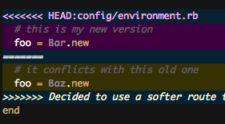
Scenario: What If His Changes and My Changes Are Not Compatible???
We changed the same lines :(
OMG!
Git (.git folder in project)
PULL
Remote repository (e.g. GitHub)
“Increased font size” (Just now)
“Fixed ur bug! -John” (Just now)
“My useful changes” (Just now)
“Database connection works” (Today)
“Fixed ur bug! -John” (Just now)
“My useful changes” (Just now)
“Database connection works” (Today)
“Created the user interface” (Yesterday)
V7
V6
V5
V4
V4
V3
V3
This is what the code actually looks like. Don’t commit it like this! Don’t click around randomly!
Image from zenadmin.com
V3
V2

Slide 43
Resolving Conflicts
At this point you’re expected to go into every conflicting file and manually fix the lines
This can be a difficult task
SmartGit, KDiff3 etc. make this easy!
You navigate conflict by conflict and decide on what the file contents should actually be

Slide 44
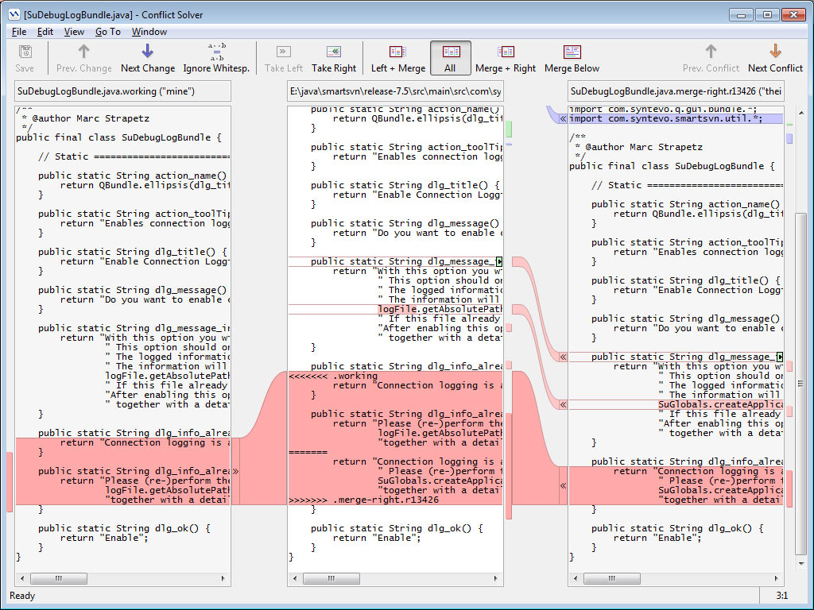
Resolving Conflicts

Slide 45
Resolving Conflicts
Ok let me resolve the conflicts
Git (.git folder in project)
Remote repository (e.g. GitHub)
“Increased font size” (Just now)
“Fixed ur bug! -John” (Just now)
“My useful changes” (Just now)
“Database connection works” (Today)
“Fixed ur bug! -John” (Just now)
“My useful changes” (Just now)
“Database connection works” (Today)
“Created the user interface” (Yesterday)
V7
V6
V5
V5
V4
V4
V3
V3
V2

Slide 46
Resolving Conflicts
Ok this looks good. Now let’s commit and push this.
Git (.git folder in project)
Remote repository (e.g. GitHub)
“Increased font size” (Just now)
“Fixed ur bug! -John” (Just now)
“My useful changes” (Just now)
“Database connection works” (Today)
“Fixed ur bug! -John” (Just now)
“My useful changes” (Just now)
“Database connection works” (Today)
“Created the user interface” (Yesterday)
V8
V6
V5
V5
V4
V4
V3
V3
V2

Slide 47
Resolving Conflicts
Ok this looks good. Now let’s commit and push this.
Git (.git folder in project)
Remote repository (e.g. GitHub)
COMMIT
Merged (Just now)
“Increased font size” (Just now)
“Fixed ur bug! -John” (Just now)
“My useful changes” (Just now)
“Fixed ur bug! -John” (Just now)
“My useful changes” (Just now)
“Database connection works” (Today)
“Created the user interface” (Yesterday)
V8
V8
V5
V6
V4
V5
V3
V4
V2

Slide 48
Resolving Conflicts
Great!
Git (.git folder in project)
PUSH
Remote repository (e.g. GitHub)
Merged (Just now)
“Increased font size” (Just now)
“Fixed ur bug! -John” (Just now)
“My useful changes” (Just now)
Merged (Just now)
“Increased font size” (Just now)
“Fixed ur bug! -John” (Just now)
“My useful changes” (Just now)
V8
V8
V8
V6
V6
V5
V5
V4
V4

Slide 49
The History Forked
Great!
Git (.git folder in project)
PUSH
Remote repository (e.g. GitHub)
Merged (Just now)
“Increased font size” (Just now)
“Fixed ur bug! -John” (Just now)
“My useful changes” (Just now)
Merged (Just now)
“Increased font size” (Just now)
“Fixed ur bug! -John” (Just now)
“My useful changes” (Just now)
V8
V8
V8
V6
V6
V5
V5
V4
V4

Slide 50
Branching
A common scenario: You diverged from your codebase. Your code won’t compile right now, but the changes you did are useful. You
don’t want to commit this because you don’t want to pollute the codebase with something that does not compile
want to commit this because you don’t want to lose these changes
At this point, create a branch (e.g. “mybranch”), which is alternative to the default “master” branch. Commit your half-baked code to “mybranch”.
Now “mybranch” is the new HEAD for you, and your working tree has the contents of “mybranch”. The master branch still has the good copy. Other people can still use the master branch just fine.

Slide 51
Switching Branches
You can switch between branches anytime (checkout)
Your working copy changes under you. Whoa!
Don’t worry. You can always switch back to the other branch.
You can push branches to a remote repository (tracked branch)

Slide 52
Merging Branches
Once your half-baked changes in “mybranch” are ready to become the new version, you want to merge it to “master”. It will be as if you had started from master and committed changes to it.
Checkout (switch to) the master branch
Merge “mybranch” into master
Resolve any possible conflicts

Slide 53
Stashing
Stashing is like creating a temporary branch.
You put the books in your hand on the table to scratch your nose, and you get the books back.
Hides your current changes in a stash and makes your repository the same as HEAD. Because maybe you wanted to pull etc.
Afterwards, you can apply the stashed changes back and delete the stash.

Slide 54
Various other operations
Cherry picking: There is a commit somewhere else that you want to apply as a change here without any other changes.
Ignore: Add file or pattern to the .gitignore file.
Revert: Create a commit that does the opposite of a previous commit.
Rebase: Starting from this commit, apply all the following commits as if they were done after this other commit.

Slide 55
Various other operations
Tag: mark a certain version for future reference. E.g., “Release v1.0”.
Releases in GitHub create tags.
Submodule: There is this library in this other repository. I want to bring it inside my own repository, but I still want to be able to receive their updates in a controlled way and push them my own updates.

Slide 56
A final tip
If you are doing this, you are doing it wrong:
“This folder A is the folder that is connected to git. I’m scared to make any changes there. I will create another copy of the project (folder B) and will work there. When I want to commit something to the repository, I’ll copy-paste that change from folder B to folder A and commit it with git later.”
NOOO! (facepalm) The whole point of git is that you should be able to work together with live codebases. If you really need a safe space to work in, just create a branch. Git makes your life easy. The scenario makes your life very difficult.

